Slide 1
Syed Taimoor Shah
Week 6
JavaScript

Slide 2
Data Types
A data type is a classification of data which tells the compiler or interpreter how the programmer intends to use the data. Most programming languages support various types of data, including integer, real/float, double, character or string, and Boolean.

Slide 3
Int or Integer
Int a=1;
Int, short for "integer," is a fundamental variable type built into the compiler and used to define numeric variables holding whole numbers.

Slide 4
Float
A float is a data type composed of a number that is not an integer, because it includes a fraction represented in decimal format.

Slide 5
Double
The double is a fundamental data type built into the compiler and used to define numeric variables holding numbers with decimal points.
Typically it is used for large numbers upto 15 digits.

Slide 6
Character
A character is a display unit of information equivalent to one alphabetic letter or symbol. This relies on the general definition of a character as a single unit of written speech. Character can also be abbreviated as "chr" or "char."

Slide 7
String
a string is traditionally a sequence of characters, either as a literal constant or as some kind of variable

Slide 8
Boolean
A boolean or bool is a data type with two possible values: true or false.

Slide 9
Variables
There are 3 ways to declare a JavaScript variable:
var
let
Const
In programming, just like in algebra, we use variables (like price1) to hold values.
In programming, just like in algebra, we use variables in expressions (total = price1 + price2).

Slide 10
var
var a;
JavaScript uses reserved keyword var to declare a variable. A variable must have a unique name

Slide 11
Let
Let a;
let allows you to declare variables that are limited to the scope of a block statement, or expression on which it is used, unlike the var keyword

Slide 12
Constant
Const a;
Once a constant is initialized, we cannot change its value. Simply, a constant is a type of variable whose value cannot be changed

Slide 13
Onclick()
onclick='document.getElementById("d").innerHTML= "Good Morning"‘
Using onclick in this specific code changes the text of that particular tag with id=“d” to “Good Morning.
The text will change only when the tag with id=“d’ is clicked.

Slide 14
innerHTML
document.getElementById("d").innerHTML= "Good Morning"
The innerHTML property is used to get or set the HTML content of an element node. The innerHTML property is part of the Document Object Model (DOM) that allows Javascript code to manipulate a website being displayed.

Slide 15
getElementByID()
document.getElementById("d").innerHTML= "Good Morning"
The Document method getElementById() returns an Element object representing the element whose id property matches the specified string.

Slide 16
If Statement
if (condition) { // block of code to be executed if the condition is true }
Use the if statement to specify a block of JavaScript code to be executed if a condition is true.

Slide 17
Example of if condition
if(5<8) {
document.getElementById("one").innerHTML="Good Morning";
}

Slide 18
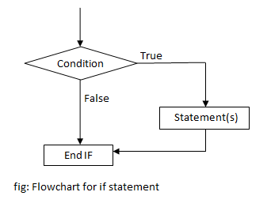
If condition flow chart

Slide 19
If else statement
if (condition) { // block of code to be executed if the condition is true } else { // block of code to be executed if the condition is false }
Use the else statement to specify a block of code to be executed if the condition is false.

Slide 20
Example of if else condition
var a=40;
var b=10;
var answer= a/b;
if(answer>b) {
document.getElementById("one").innerHTML="Good ";
}
else {
document.getElementById("one").innerHTML="Good Bye";
}

Slide 21
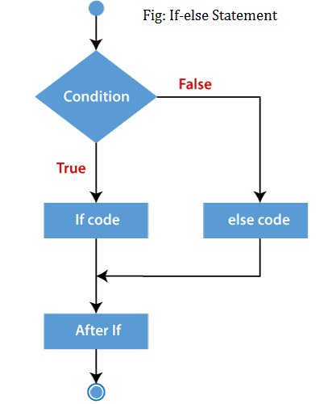
If else condition flow chart

Slide 22
If else if
if (condition1) { // block of code to be executed if condition1 is true } else if (condition2) { // block of code to be executed if the condition1 is false and condition2 is true } else { // block of code to be executed if the condition1 is false and condition2 is false }
Use the else if statement to specify a new condition if the first condition is false.

Slide 23
Example of if else-if
var b=10;
var f=9;
var c=b+f
console.log(c);
document.getElementById("a").innerHTML=c;
if(c>f) {
document.getElementById("one").innerHTML="C is greater than f ";
}
else if(c<f) {
document.getElementById("one").innerHTML="C is smaller than f";
}
else if(c==f) {
document.getElementById("one").innerHTML="C is equal to F";
}
else {
document.getElementById("one").innerHTML="Good Bye";
}

Slide 24
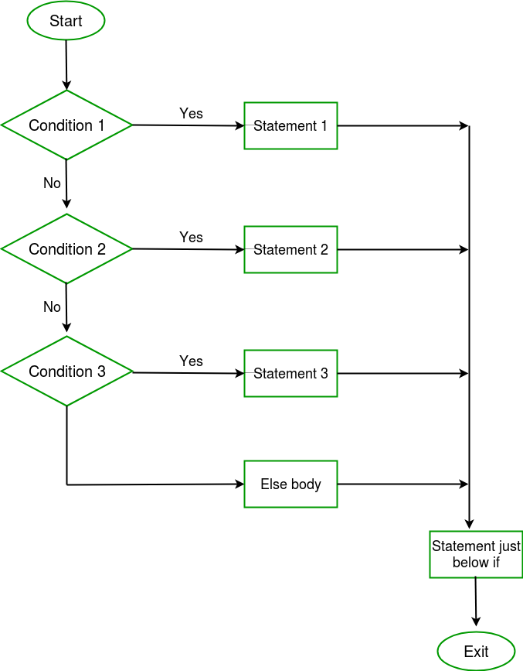
If else-if condition flow chart

Slide 25
Switch Statement
switch(expression) { case x: // code block break; case y: // code block break; default: // code block }
Use the switch statement to select one of many code blocks to be executed.

Slide 26
Working of Switch
This is how it works:
The switch expression is evaluated once.
The value of the expression is compared with the values of each case.
If there is a match, the associated block of code is executed.
If there is no match, the default code block is executed.
The default keyword specifies the code to run if there is no case match

Slide 27
Break
When JavaScript reaches a break keyword, it breaks out of the switch block.
This will stop the execution inside the switch block.
It is not necessary to break the last case in a switch block. The block breaks (ends) there anyway.

Slide 28
For loop
for ( initialization condition ; termination condition ; increment condition )
{
statement ( s ) ;
}
For loops are commonly used to count a certain number of iterations to repeat a statement. Use a break statement to exit the loop before the condition expression evaluates to false.

Slide 29
For loop cont…
We see that a 'for statement' consists of three parts.
In initialization condition, we initialize some variable while in continuation condition,
we set a condition for the continuation of the loop.
In third part, we increment the value of the variable for which the termination condition is set.

Slide 30
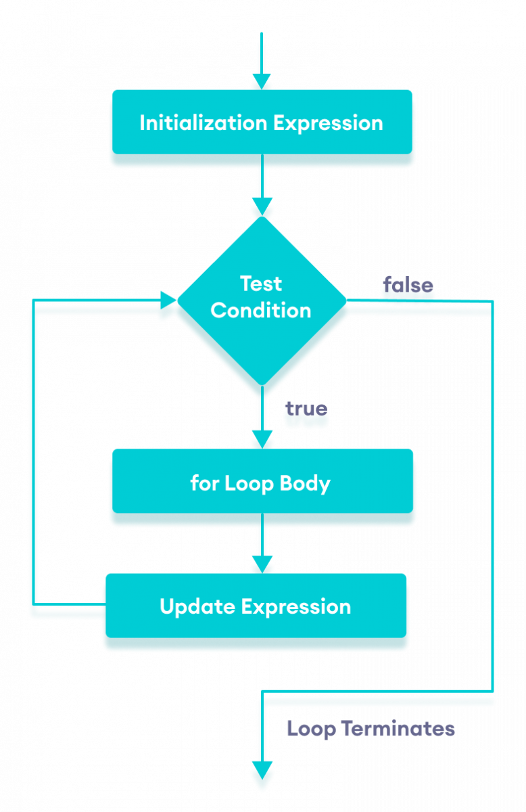

Slide 31
While loop
while (condition)
{
statements;
}
In while loop, the condition is tested first and the statements in the body are executed only when this condition is true. If the condition is false, then the control goes directly to the statement after the closed brace of the while loop.

Slide 32
Do-while loop
do
{
statements ;
}
while ( condition ) ;
The do-while loop statement creates a loop that executes a block of code until a test condition evaluates to false

Slide 33
Increment operator
counter ++ ;
same as
counter = counter + 1;

Slide 34
Decrement operator
counter -- ;
same as
counter = counter - 1

Slide 35
+=
counter += 3 ;
same as
counter = counter + 3 ;

Slide 36
-=
counter -= 5 ;
same as
counter = counter – 5 ;

Slide 37
*=
x*=2
x = x * 2

Slide 38
/=
x /= 2
x = x / 2

Slide 39
%=
x %= 2 ;
same as
x = x % 2 ;

